Slide 1



Vehicle Emission Detection using YOLOv8

Slide 2

Learning Objectives
Understand the impact of vehicle emissions on air quality and health
Learn the basics of object detection using YOLOv8
Gain hands-on experience with dataset preprocessing and annotation
Apply machine learning to detect visible smoke from vehicles
Train, validate, and test a custom YOLOv8 model
Analyze model performance using metrics (Precision, Recall, mAP)
Demonstrate inference results on real-world images
Identify challenges (false positives, dataset imbalance) and propose improvements
Explore the potential of deploying this system for real-time traffic monitoring
GOAL
Source :
www.freepik.com

Slide 3
Tools and Technology used
Source:
Dataset collected from public sources (vehicles + smoke images)
Preprocessing scripts for cleaning and labeling data
YOLOv8 framework from Ultralytics as base model
Tools and Technology:
Programming Language: Python
Framework: Ultralytics YOLOv8
Libraries: OpenCV, Matplotlib, Torch
Version Control: Git & GitHub
Dataset Storage: Google Drive

Slide 4
Methodology
Problem Identification
Recognizing vehicle smoke emission as a major cause of air pollution.
Data Collection
Gathered vehicle + smoke images from open datasets
Data Preprocessing
Resized images, verified labels, removed duplicates/corrupt files
Model Training
Trained YOLOv8 model on annotated dataset
Validated using precision, recall, mAP
Model Evaluation
Analyzed training curves & confusion matrix
Inference & Analysis
Ran predictions on test images
Compared correct detections vs false positives
Deployment Readiness
Saved best weights for future real-time use

Slide 5
Problem Statement:
Vehicle smoke emissions are one of the leading contributors to urban air pollution.
Currently, smoke detection is carried out manually, which is inefficient, time-consuming, and prone to human error.
There is a need for an automated, AI-based system that can accurately detect and monitor vehicles emitting visible smoke, ensuring better pollution control and assisting traffic authorities in enforcement.

Slide 6
Solution:
Developed an AI-powered system using YOLOv8 for smoke emission detection.
Detects and localizes vehicles emitting visible smoke with bounding boxes.
Uses a labeled dataset of vehicles with/without smoke for training.
Automatically processes new images or CCTV footage in real-time.
Reduces manual effort and human error in monitoring emissions.
Can generate alerts for traffic authorities when smoke is detected.
Scalable for smart city deployments and pollution control initiatives.
Provides a foundation for integrating with government databases and smart traffic systems.

Slide 7
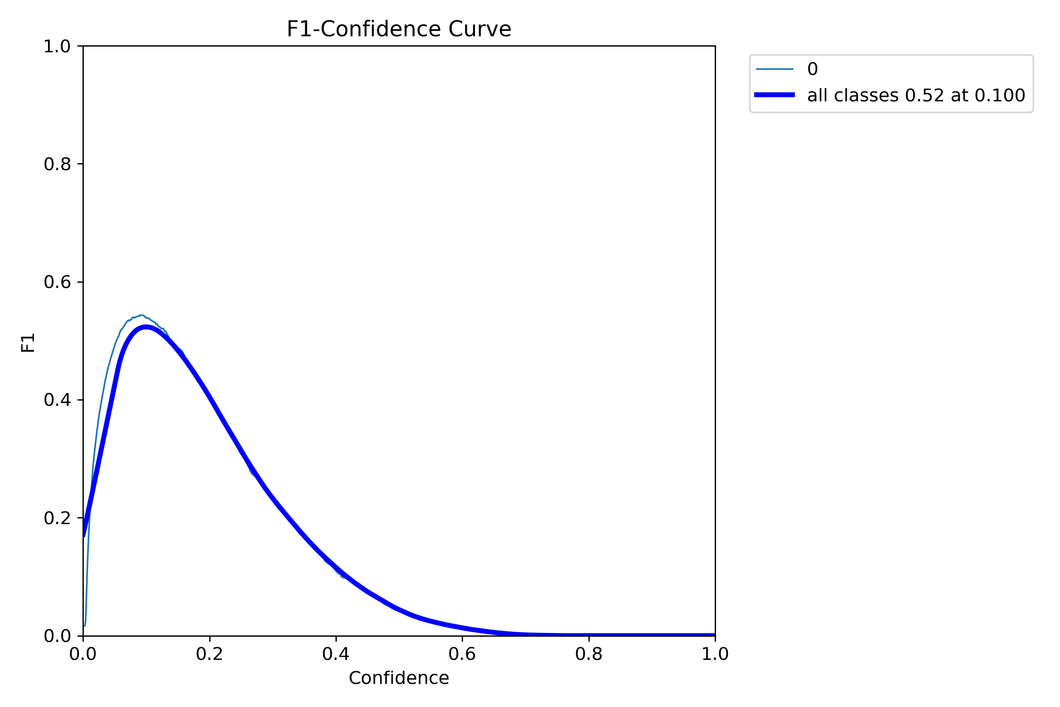
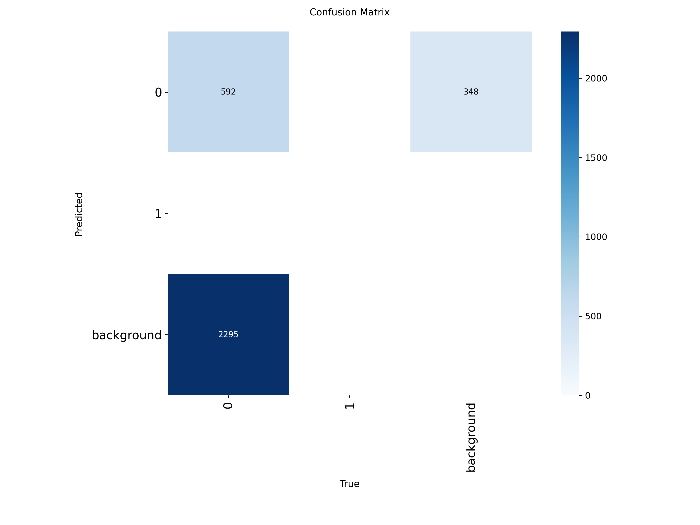
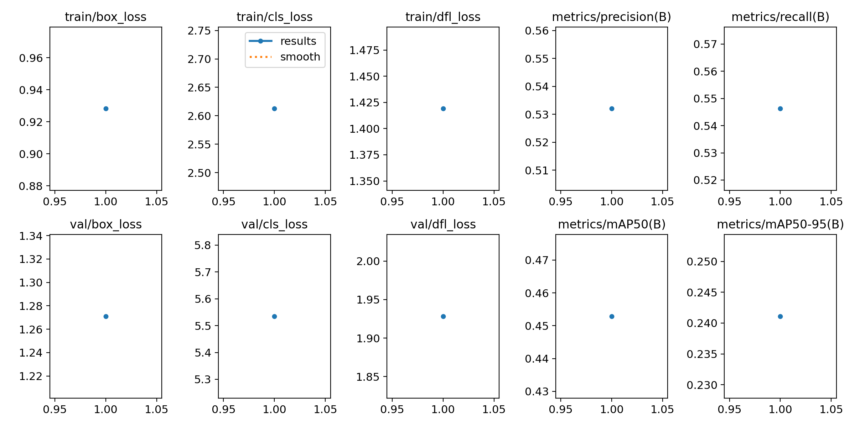
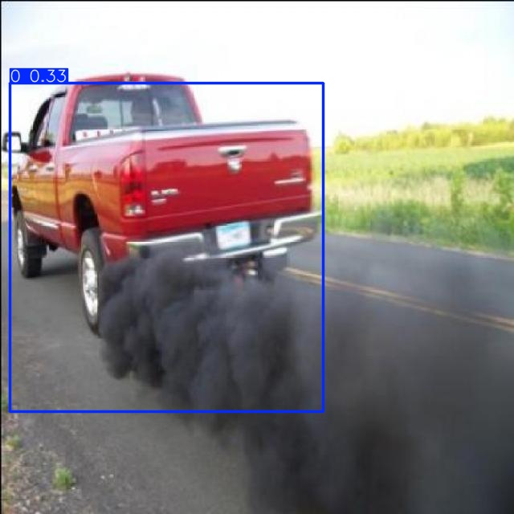
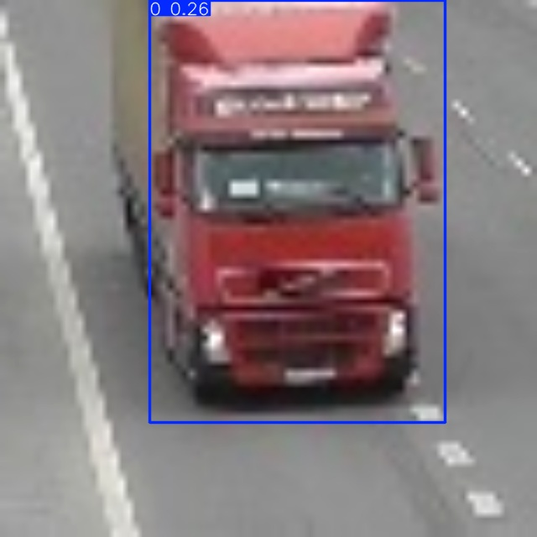
Screenshot of Output:
Training Curve
Confusion Matrix
Results
Correct Detection
False Positive

Slide 8
Future Scope:
Train on larger and more diverse datasets to improve accuracy.
Increase training epochs for better learning of smoke patterns.
Reduce false positives using advanced post-processing techniques.
Deploy the system for real-time monitoring with CCTV integration.
Integrate with traffic police databases for automated alerts.
Extend the model to detect other pollution sources (e.g., industrial smoke).
Explore cloud-based deployment for scalability in smart cities.

Slide 9
Conclusion:
Successfully implemented a YOLOv8-based system for detecting vehicle smoke emissions.
The model is able to identify vehicles emitting visible smoke with reasonable accuracy.
Demonstrated both correct detections and false positives during testing .
Limitations observed: small dataset size, few training epochs, occasional false positives.
Despite limitations, the project proves that AI can be effectively applied for environmental monitoring.
The system shows potential for real-world deployment in smart cities for traffic and pollution control
With larger datasets, longer training, and fine-tuning, accuracy can be further improved.
This project provides a foundation for future research in automated emission detection and enforcement systems

